Slide 1


Creating and Using a Java .jar file
IT-2650
Martin Walsh, Instructor

Slide 2
What is a Java JAR File?
JAR file (.jar) is a compressed file that contains an application’s compiled code (.class), images, and other folders and files needed by the application.
JAR = Java Archive (one reduced size file that holds all folders and files of an application)
Purpose: To make it easier to distribute Java applications

Slide 3

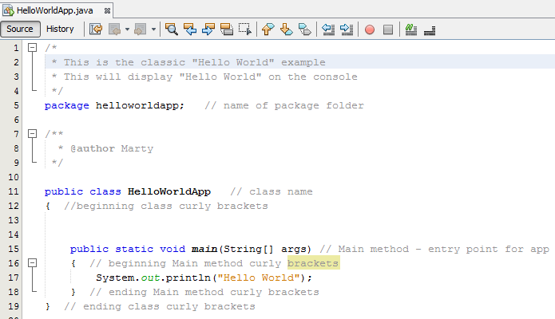
JAR File Example - HelloWorldApp

Slide 4
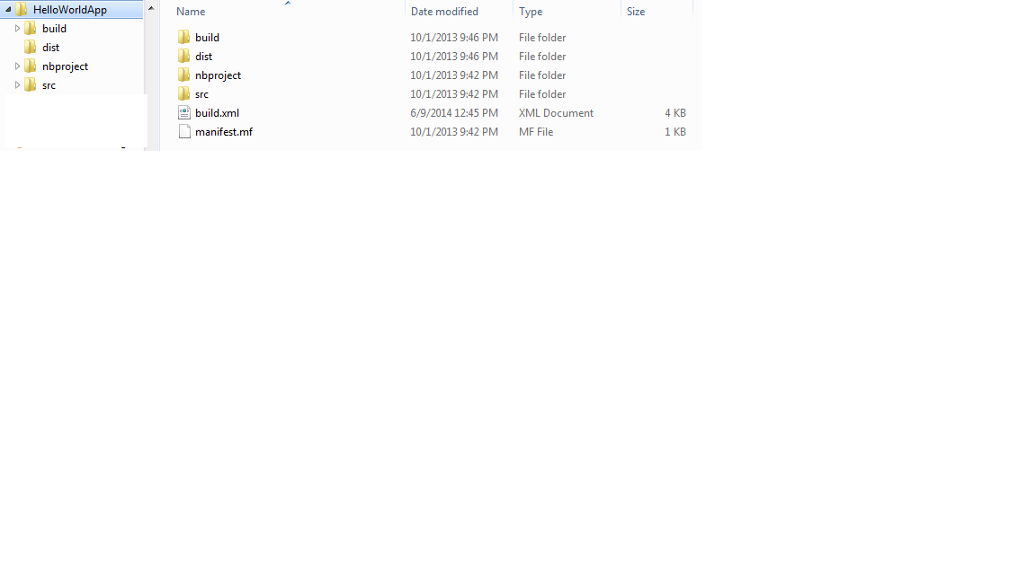



JAR File Example (continued)
HelloWorldApp – Project Package folder contents
Combined and compressed in JAR file (HelloWorldApp.jar)
Source code – in src folder
Compiled code – in build folder
Archived project – JAR file in dist folder

Slide 5
How Do You Create a JAR file?
Easiest way is to use NetBeans IDE
  Identify class file with Main method first
  Use “Clean and Build” command from Run menu
  IDE creates “dist” folder with .jar file
Manually from the Windows Command Prompt
  Use “jar” command with options
    Go to the HelloWorldApp folder
    Enter “C:\> jar cfv HelloWorldApp * “ (without quotes) to include all files and folders in JAR file
    By default, file given .jar extension, manifest created, all files and folders compressed.

Slide 6
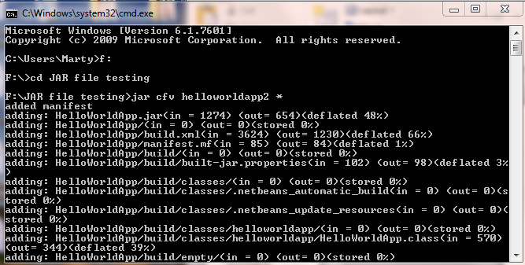
Manually Creating a JAR File Example
Go to the drive and folder that contains the Java application files
Enter “ c:\> jar cfv helloworldapp2 * “ (without quotes) to create the JAR file
Wildcard character “*” includes all files in folder
If you want specific files, list them individually separated by a space
  Generally, you only need .class files and images
You can use any name for the JAR file, it does not have to be the same as the underlying Java application

Slide 7
How Do You Use a JAR File?
Use it to distribute Java application to others
  Easier to distribute all of project package files and folders since everything compressed into one file
Make Java application executable for users that don’t have NetBeans IDE or JDK
  Users must have Java Runtime installed (check version)
  JAR file manifest must identify class file with Main method
  Double-click to run application
    Double-click executable .jar file or
    Double-click .bat script file that runs Java jar command
  Create shortcut to run Java application
  Windows must associate .jar files with Java Runtime

Slide 8
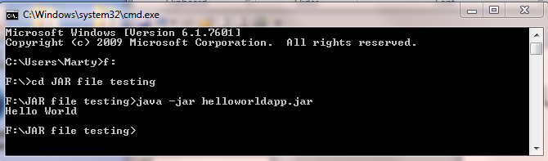
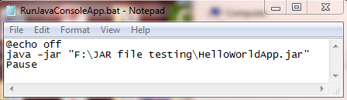


Using an Executable JAR File
Use Java Interpreter to run JAR file
Enter “java –jar helloworldapp.jar” (without quotes) to run app in window
Use a Windows .bat file with a desktop shortcut to run the JAR file
The user simply double-clicks on the desktop shortcut to run app

Slide 9
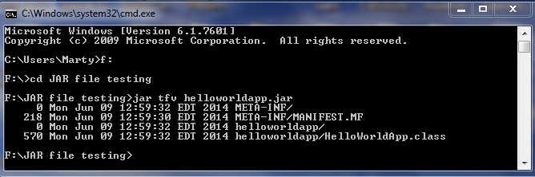
How Can You View JAR File Contents?
Issue JAR command from Command Prompt
  Go to JAR file folder
  Type “C:\> jar tfv helloworldapp.jar” (without quotes) to display contents (detailed view) to screen

